Slide 1
The Request/Response Cycle
Or, what happens when you type something into the address bar

Slide 2
How Does This All Work?
When you type an address into the URL bar, what happens?
Warning: This lecture is heavy on the acronyms.

Slide 3

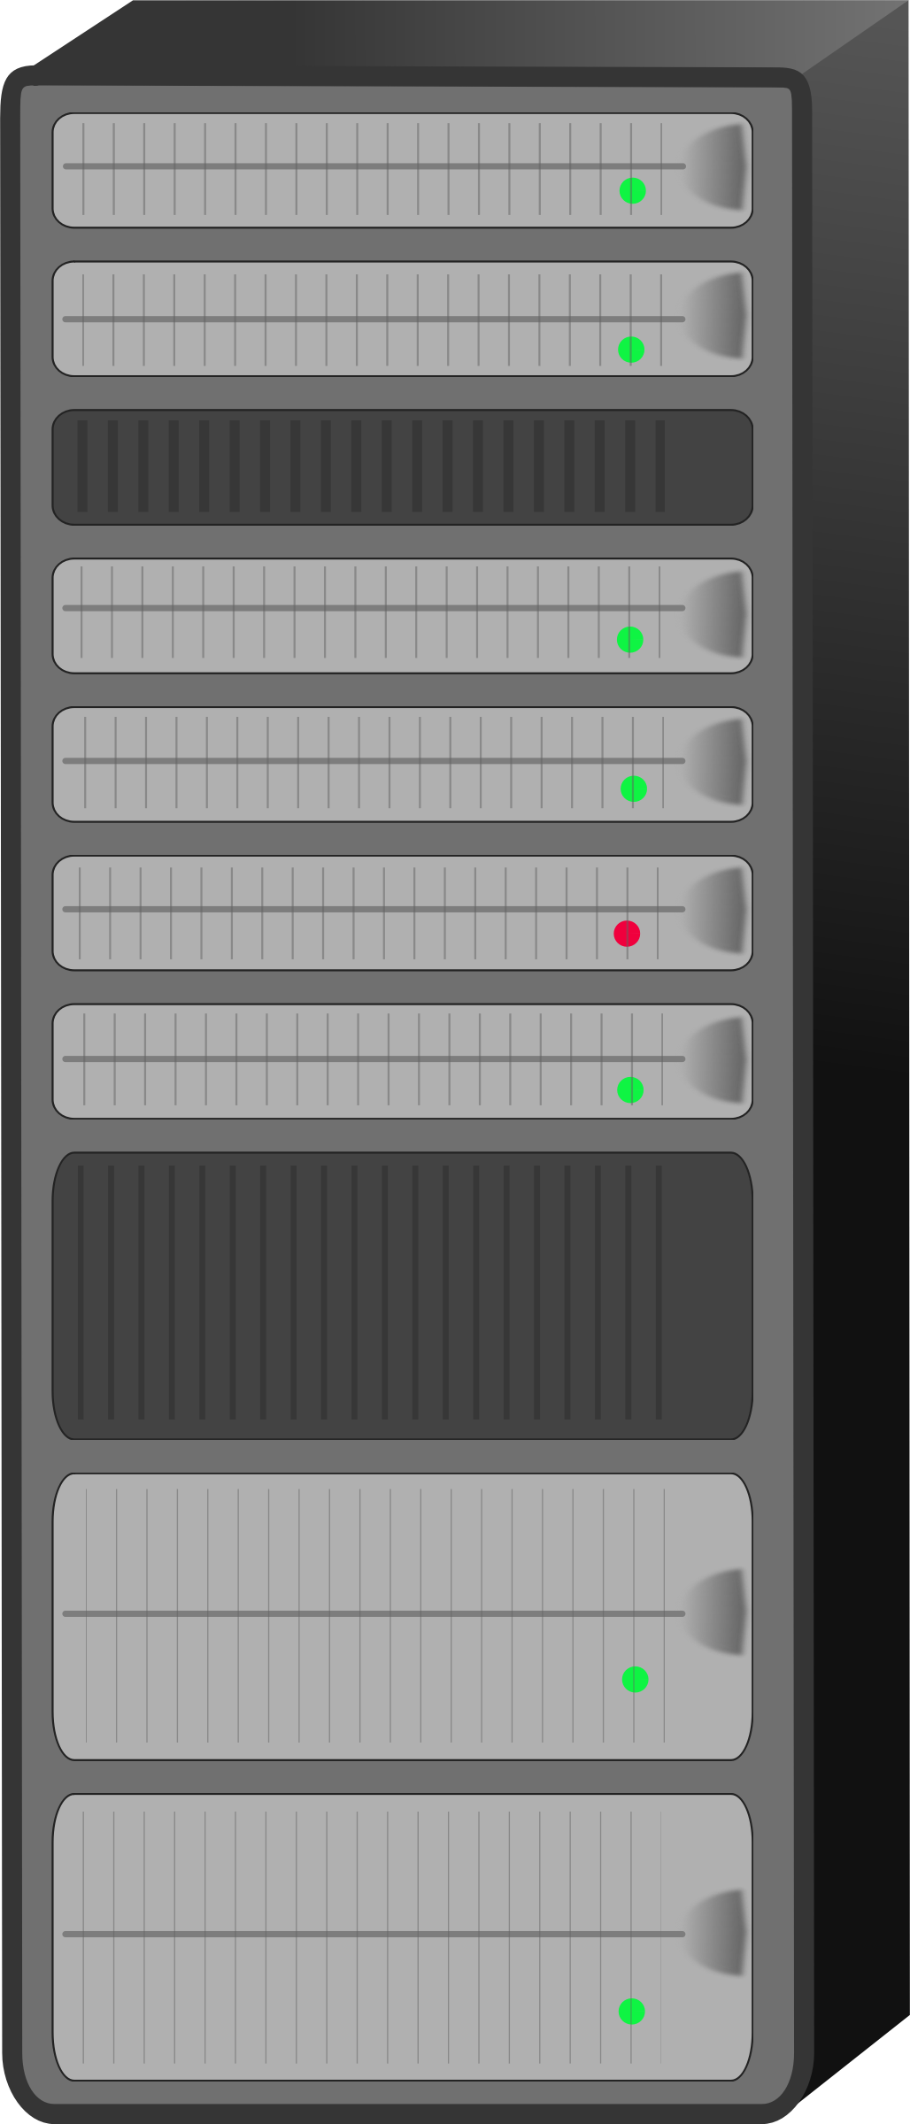
Networks
z
The Internet
LAN
WAN
WAN
LAN

Slide 4
Client/Server Relationship
Servers
Machines that hold shared resources
Always connected to the network
Clients
Machines for personal use (laptops, phones, etc.)

Slide 5
Request/Response Cycle
This is what happens when your computer (the client) requests a page and a server responds with the appropriate files.

Slide 6
Uniform Resource Locator
URL – three parts:
protocol – how to connect
domain – where to find the document you want
document – what specific file is needed*
Most pages are made up of multiple files

Slide 7
Protocols
HTTP – Hypertext Transfer Protocol
HTTPS – Secure Hypertext
Transfer Protocol
FTP – File Transfer Protocol

Slide 8
Domain Names
Identifies the entity you want to connect to
umich.edu, google.com, wikipedia.org
Each has different top-level domain
Determined by Internet Corporation for Assigned Names and Numbers (ICAAN)
https://www.icann.org/resources/pages/tlds-2012-02-25-en

Slide 9
IP Addresses and the Domain Name Server (DNS)
Internet Protocol Version 4 (Ipv4) uses number format of xxx.xxx.xxx.xxx to identify each domain
can represent over 4 billion unique combinations (2³²)!
DNS looks up the domain and returns the IP address

Slide 10
Document
URLs can specify a specific document
http://www.intro-webdesign.com/contact.html
http://www.intro-webdesign.com/Ashtabula/harbor.html
If no document is specified, the default document is returned.
Convention is index.html

Slide 11
The Request
Once the IP address is determined, the browser creates an HTTP request.
Lots of hidden information in this request
header, cookies, form data, etc

Slide 12
The Response
The server returns files, not “web pages”
It is up to the browser to decide what to do with those files
If the server can’t fulfill the request it will send back files with error codes: 404, 500, etc.

Slide 13
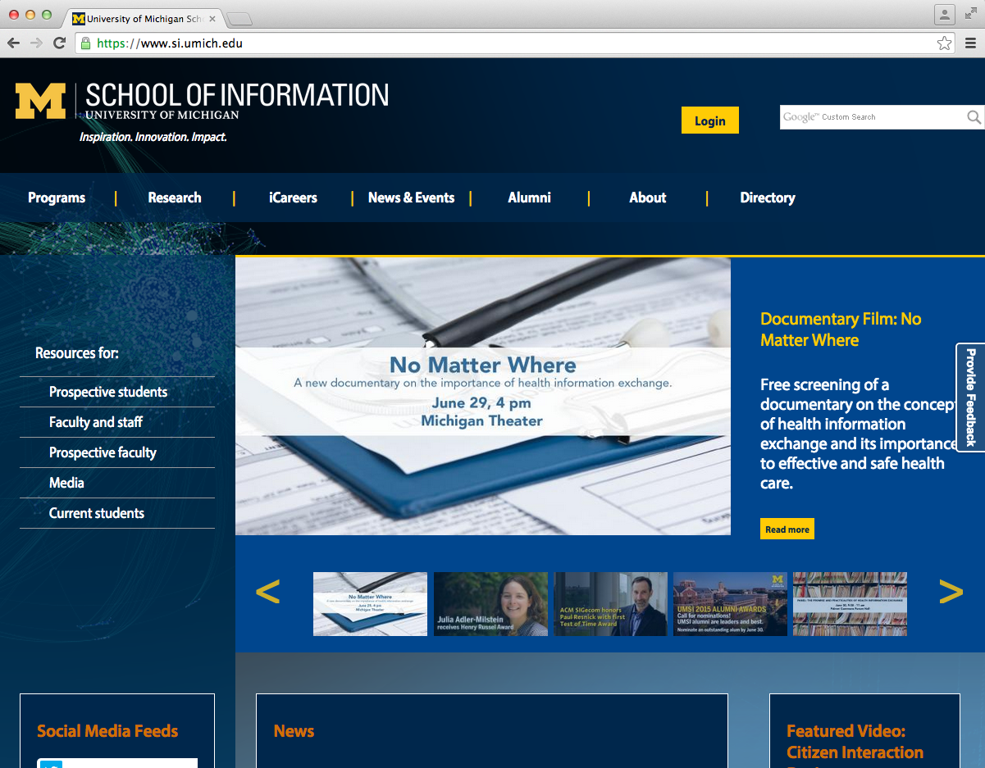
What happens when you type “http://si.umich.edu/” into the address bar.
1. The browser look up the domain in the DNS
The Request/Response Cycle is initiated
2. The DNS returns the IP address:54.88.175.189
3. The browser sends an HTTP request to the server located at that address.
4. The server finds the requested file and sends it back as a response.
5. The browser takes the response and renders the HTML code as a nice graphical presentation, often repeating steps 3 – 4 as needed to request images and other supporting files.

Slide 14
Additional Notes
Live Example
A new protocol IP Version 6 (Ipv6) will increase the number of combinations to 2¹²⁸.
High-level domain name examples

Slide 15
Original | Country | Generic
.org | .au | .airforce
.net | .br | .biz
.int | .de | .community
.edu | .ie | .jobs
.gov | .uk | .travel
.arpa | .us | .wiki

Slide 16
Review
A URL has three parts.
Request/Response cycle typically requires multiple rounds of communication between the client and server.

Slide 17
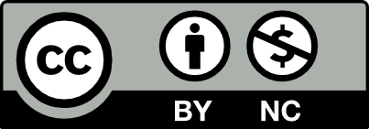
Acknowledgements/Contributions
These slides are Copyright 2015- Colleen van Lent as part of http://www.intro-webdesign.com/ and made available under a Creative Commons Attribution-NonCommercial 4.0 License. Please maintain this last slide in all copies of the document to comply with the attribution requirements of the license. If you make a change, feel free to add your name and organization to the list of contributors on this page as you republish the materials.
Initial Development: Colleen van Lent , University of Michigan School of Information

